Slide 1

Sentiment Analysis for Marketing Optimization
Final Year Project
17th May, 2022
Guide
Prof. Suraj Sharma
Students
Vikalp Kumar B218052 Rishikesh Ranjan B418037

Slide 2
Outline
Problem Statement
Purpose, Scope and Objective
Literature Survey
Code & Result
Future Opportunities & Conclusion

Slide 3
Problem Statement
Marketing is the most important part of any company or startup to expand and it is necessary that is is done with perfection.
We don't know most of the time which content that we use in our social media post are people going to like.
So we have extracted some data from twitter from tried an experiment which will in future give a big boost to people trying to perfect their content before publishing it on their official company social media account or their personal social media account.

Slide 4
Purpose, Scope and Objective
PURPOSE
To help marketers and startup founders understand what kind of content their followers are liking and give opinion based on the behavior of regular customers.
SCOPE
The same app that we have developed can be used in many different places after training it for more accuracy and different dimensions. It can be used for detecting the virality of a post. It can used to detect if the post is going to get banned or not.

Slide 5
OBJECTIVE
Objective of this project is to identify if a submitted text is positive, negative or neutral.

Slide 6
Literature Survey
WEB SCRAPING
Web scraping is a means of extracting vast volumes of data from websites in an automated manner.
NATURAL LANGUAGE PROCESSING
Natural language processing (NLP) is the ability of a computer software to interpret spoken and written human language, often known as natural language. It's a part of AI (artificial intelligence) (AI).
SCIKIT LEARN
In Python, Scikit-learn (Sklearn) is the most usable and robust machine learning library. It uses a Python consistency interface to give a set of efficient tools for machine learning and statistical modeling, such as classification, regression, clustering, and dimensionality reduction.

Slide 7
Literature Survey
BAG OF WORDS
A bag-of-words model, or BoW for short, is a method of extracting text attributes for use in modeling, such as machine learning techniques.
LOGISTIC REGRESSION
This sort of statistical analysis (also known as a logit model) is commonly used for predictive analytics and modeling, as well as machine learning applications.

Slide 8
Codes

Slide 9
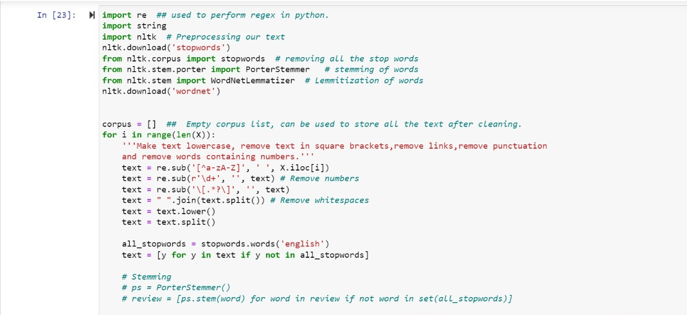
Text Pre-Processing

Slide 10
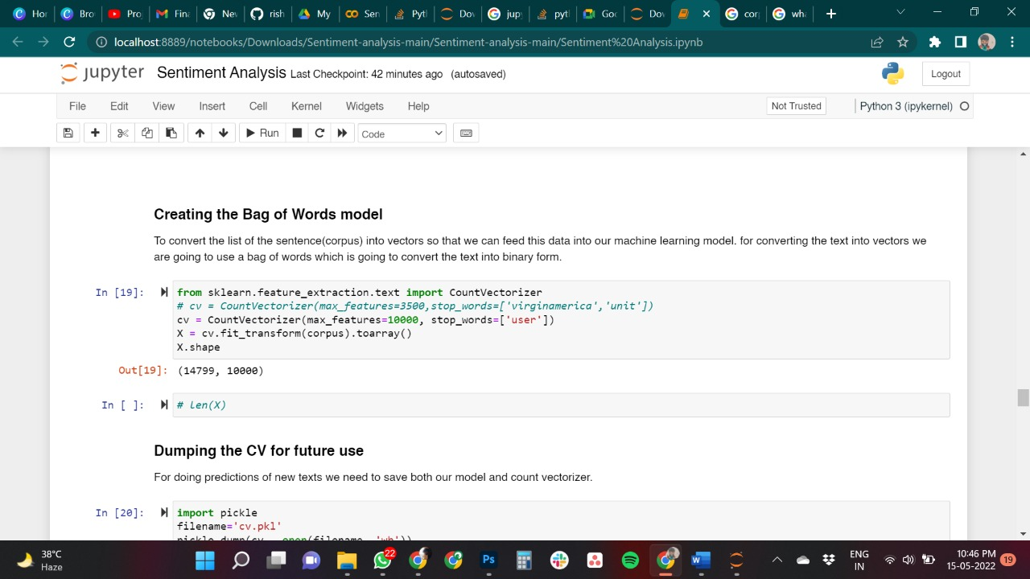

Slide 11
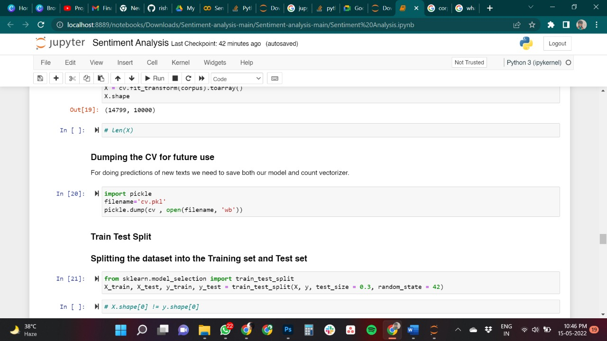

Slide 12
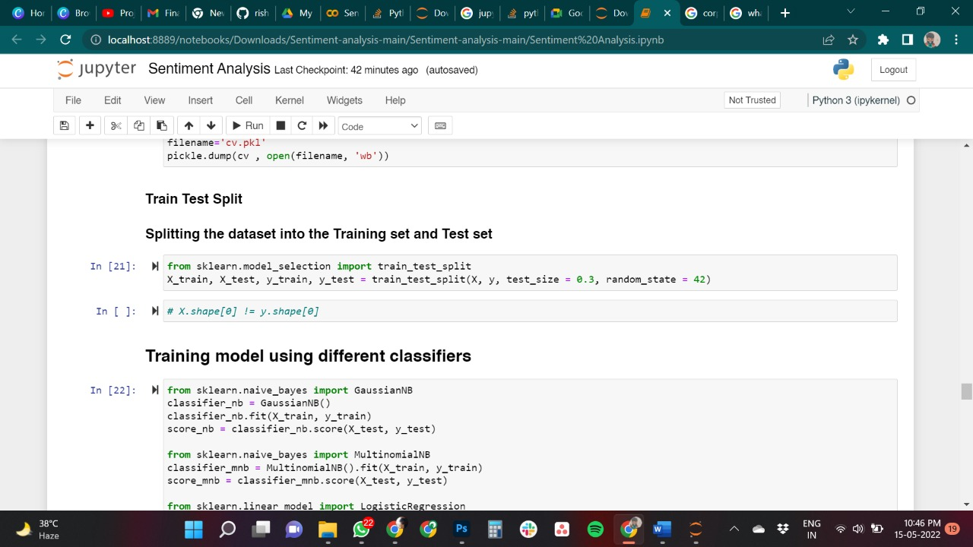

Slide 13
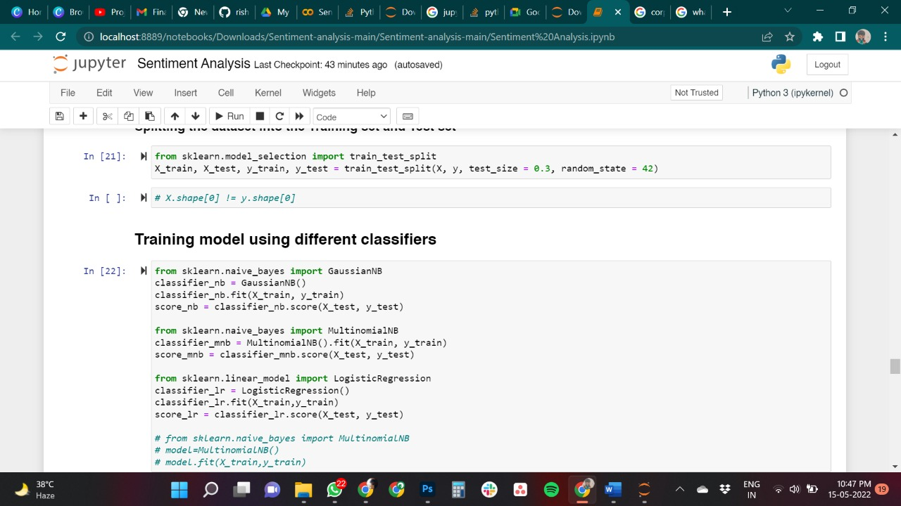

Slide 14
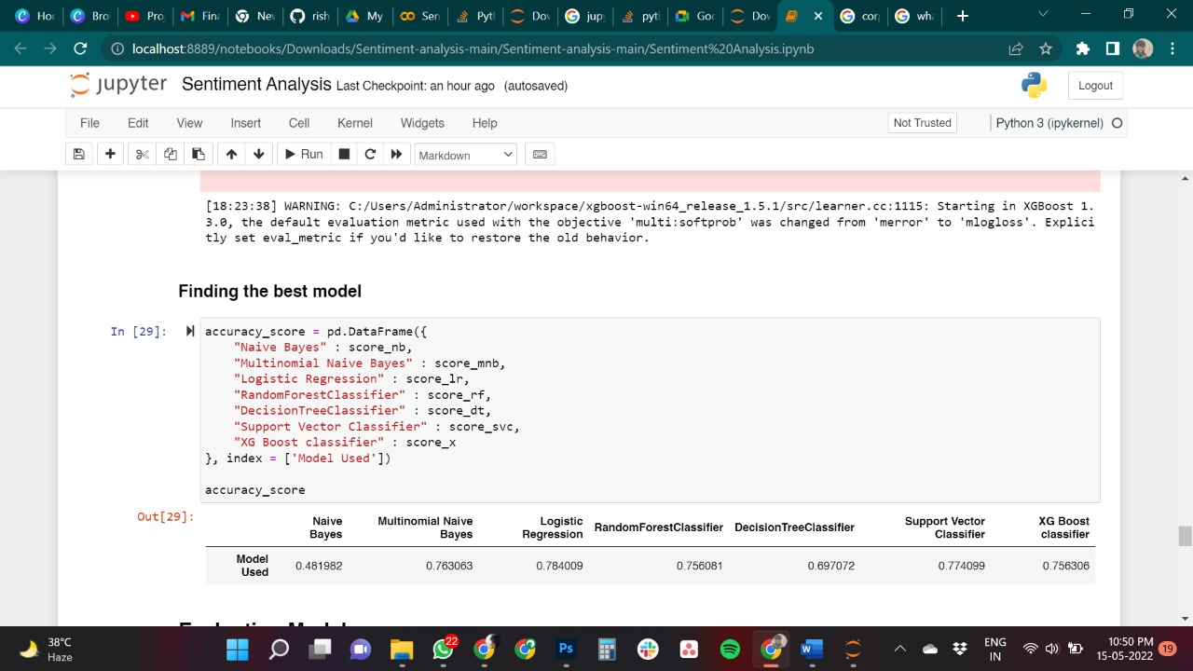

Slide 15
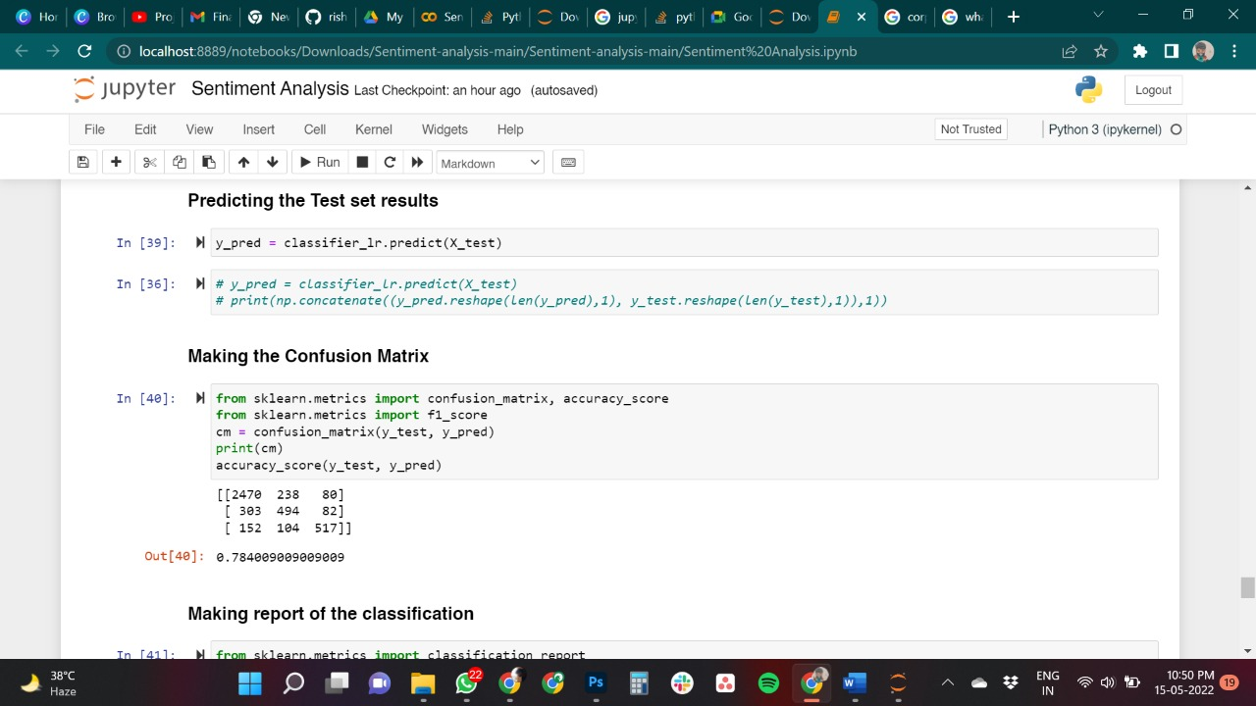

Slide 16
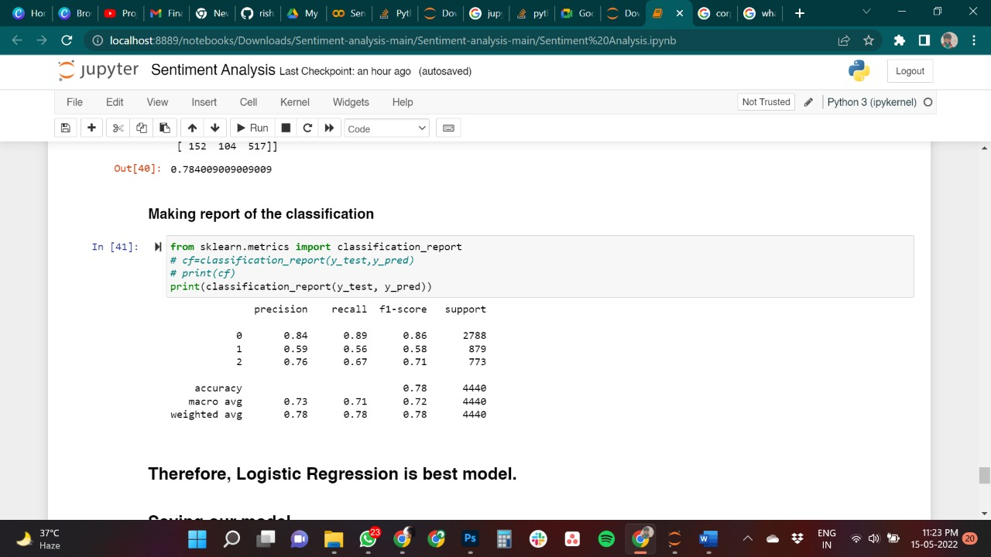

Slide 17
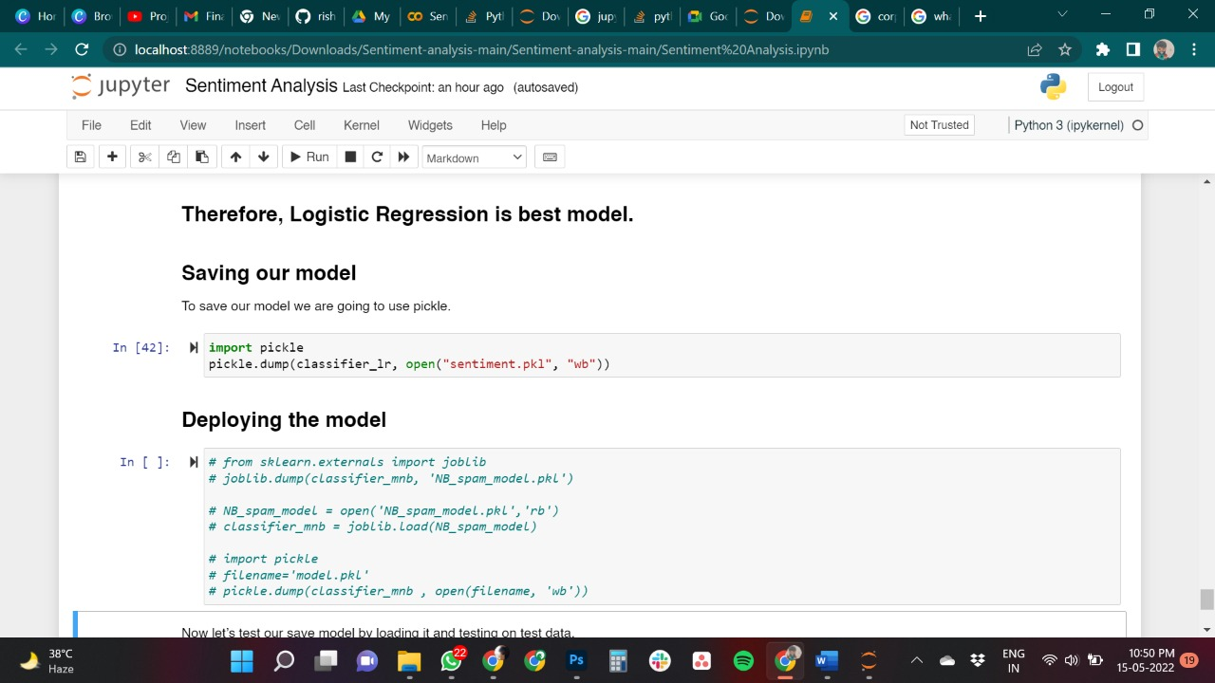

Slide 18
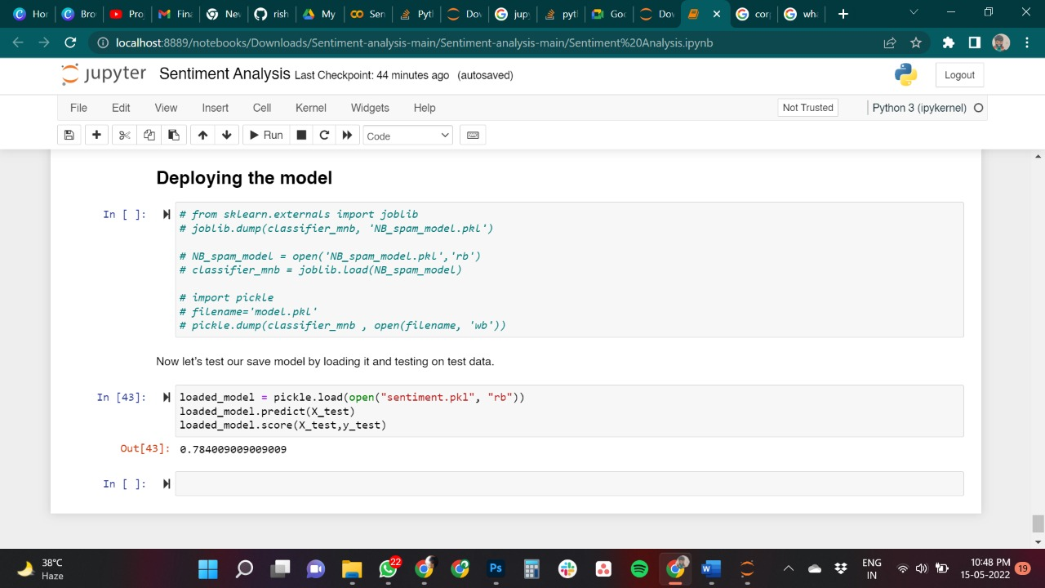

Slide 19
Demo

Slide 20
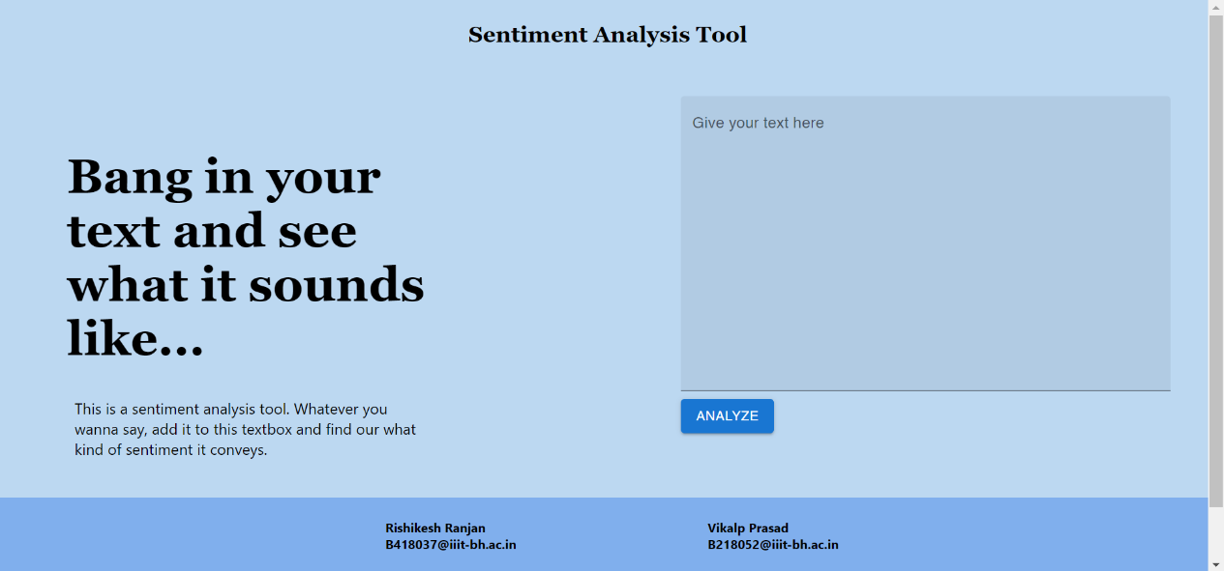

Slide 21
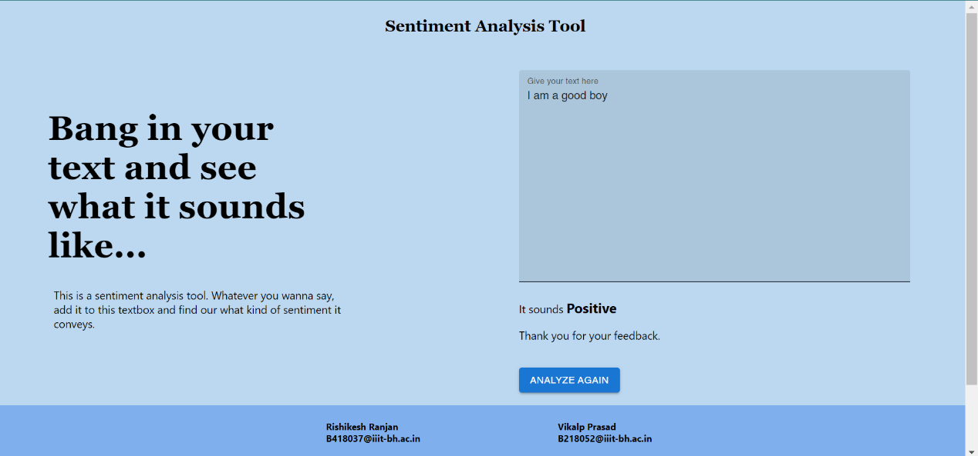

Slide 22
Conclusion & Future Opportunities
1) This Project has multiple future uses. The one that we are going to implement is in writing business plans.
After talking to 15 Angle investor, we got to know the major principles of how investors judge before investing in a startup and who kind of tone they like to see in a business plan.
We are going to develop a text based ML powered business plan writer which can be directly shared with the investors. Every time a business plan is accepted by an investor the program learns more and more about the emotions related to why some startup get funded and some don’t.
2) To detect the virality of a social Media Post. Using web scaping we can collect social media posts of public posts and training the model other variables such a number of followers and number of comments and likes, We can get an idea of what kind of post will have a virality coefficient of more than 1.`

Slide 23

Thank You

